Slide 1
OS Concept Map 3 – May 15
Agenda
Module A.6 OS Concept Map
Discussion: Topic C – Memory Allocation
Continue Level 1 Research
Catch-Up
See Spreadsheet for Missing / Incomplete Work
Upcoming
Tue, May 21st : OS Concept Map Due

Slide 3
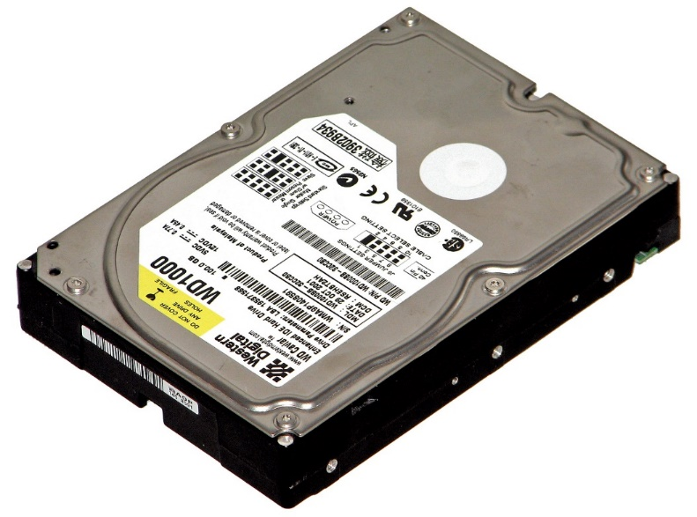
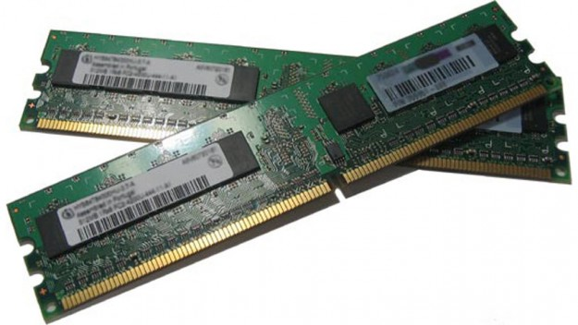
Memory Organization
Computer Architecture

Slide 4
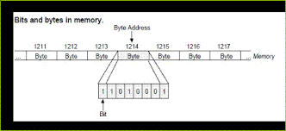
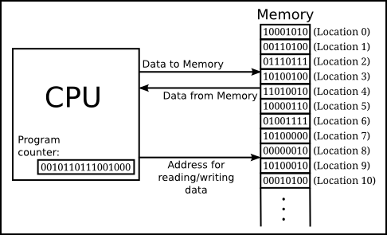
Main Memory (e.g. RAM)
Main Memory
Main
Data
Storage
(0.5–4 Gb)
Program
Storage
(0.5–4 Gb)
High Speed
Memory Bus
Central
Processor
Motherboard

Slide 5
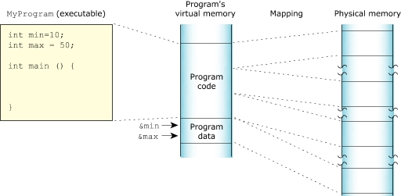

Slide 6
External Memory (e.g. Hard Disk Drive)
Main Memory
Main
Data
Storage
Program
Storage
IDE or SATA
Cable Interface (Slower Speed)
Data
&
Program
Storage (0.5-4 Tb)
High Speed
Memory Bus
Central
Processor
External Memory
Motherboard

Slide 7
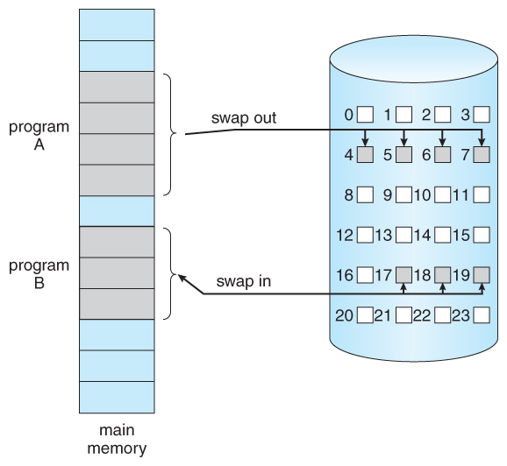

Slide 8
Cache Memory
Main Memory
Main
Data
Storage
Program
Storage
Data
&
Program
Storage (0.5-4 Tb)
Cache
Cache Features:
Extreme High Speed
Small Size (512 Mb)
Buffer
Pre-fetch
Cache
Central
Processor
External Memory
Motherboard

Slide 10
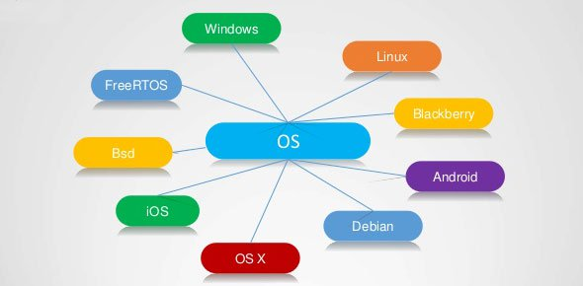

Slide 11
Topic A – Application & OS Layers
Computer Organization (Layers)
Hardware Layer
CPU
RAM
Memory
Display
Mouse /
Keyboard
DISKS

Slide 12
Topic A – Application & OS Layers
Computer Organization (Layers)
Application
(Program) Layer
MS Word
(Office)
Chrome
(Web)
Photoshop
(Media)
Other Apps
Hardware Layer
CPU
RAM
Memory
Display
Mouse /
Keyboard
DISKS

Slide 13
Topic A – Application & OS Layers
Computer Organization (Layers)
Application
(Program) Layer
MS Word
(Office)
Chrome
(Web)
Photoshop
(Media)
Other Apps
High End Game
Operating
System Layer
(Software)
Task
Scheduler
Memory
Allocation
Device
Manager
Display Control
I/O Interrupts
Hardware Layer
CPU
RAM
Memory
Display
Mouse /
Keyboard
DISKS

Slide 14
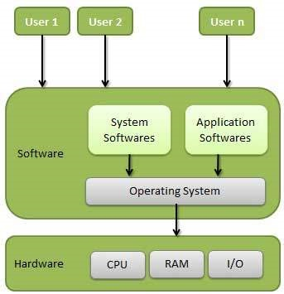
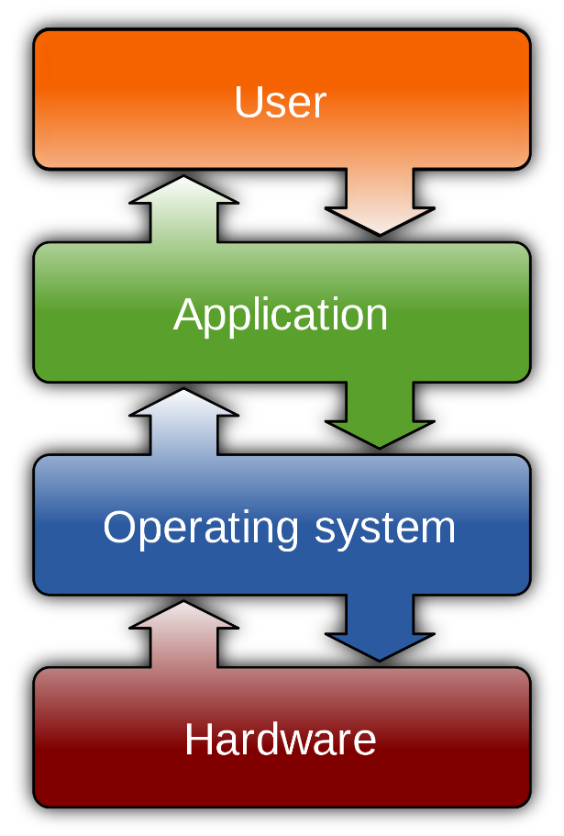

Slide 15
Topic A – Application & OS Layers
Common Computer Tasks (Operations)
E.g. Open A Program
Application
(Program) Layer
MS Word
(Office)
Chrome
(Web)
Photoshop
(Media)
Other Apps
Operating
System Layer
(Software)
Task
Scheduler
Memory
Allocation
Device
Manager
Display Control
I/O Interrupts
Hardware Layer
CPU
RAM
Memory
Display
Mouse /
Keyboard
DISKS

Slide 16
Topic A – Application & OS Layers
Common Computer Tasks (Operations)
E.g. Open A Program
Application
(Program) Layer
MS Word
(Office)
Chrome
(Web)
Photoshop
(Media)
Other Apps
Operating
System Layer
(Software)
Task
Scheduler
Memory
Allocation
Device
Manager
Display Control
I/O Interrupts
Hardware Layer
CPU
RAM
Memory
Display
Mouse /
Keyboard
DISKS

Slide 17
Topic A – Application & OS Layers
Common Computer Tasks (Operations)
E.g. Typing Some Text
Application
(Program) Layer
MS Word
(Office)
Chrome
(Web)
Photoshop
(Media)
Other Apps
Operating
System Layer
(Software)
Task
Scheduler
Memory
Allocation
Device
Manager
Display Control
I/O Interrupts
Hardware Layer
CPU
RAM
Memory
Display
Mouse /
Keyboard
DISKS

Slide 18
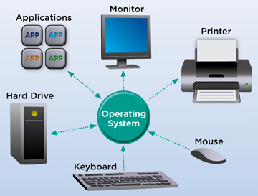

Slide 20
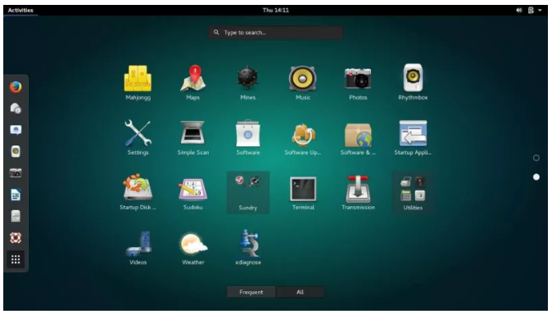

Slide 21
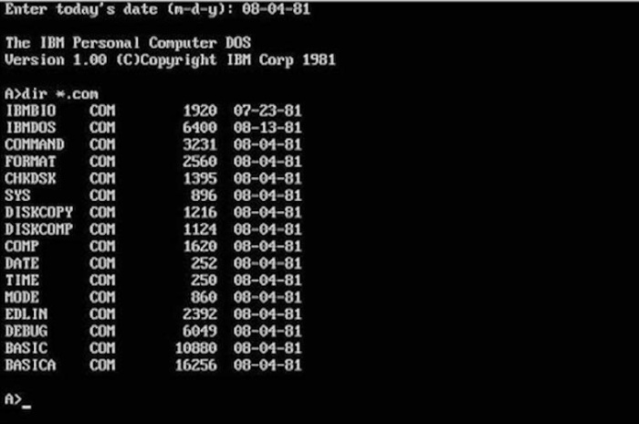
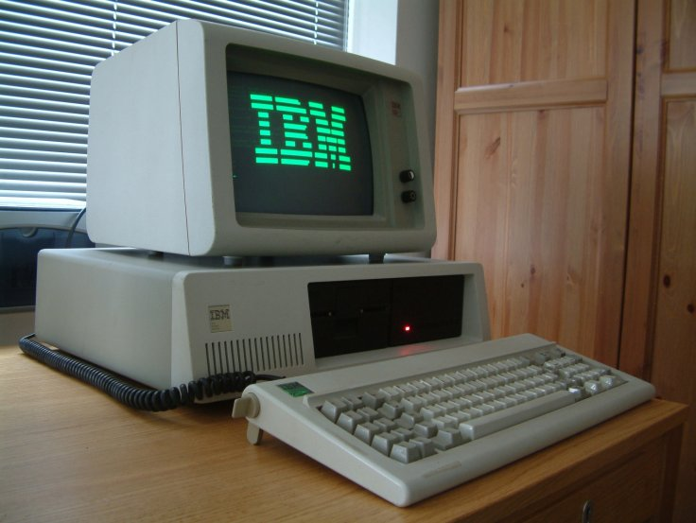
Topic B – Window Interface
Early Computers (DOS Based)
Command Line (Console)
One Program At A Time
Full Screen Display
No Mouse

Slide 22
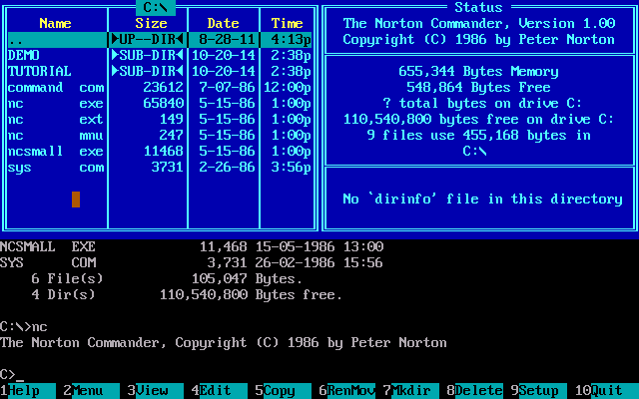
Topic B – Window Interface
Norton Commander / DOS Shell
Runs as a “Shell” on top of DOS
Still Full Screen / Text Based (No Mouse)
Still One Program At A Time
Added the Ideas of:
Menu Items
Hot Keys
Visual Organization
Improved the:
management of files
Speed of accessing and opening applications

Slide 23
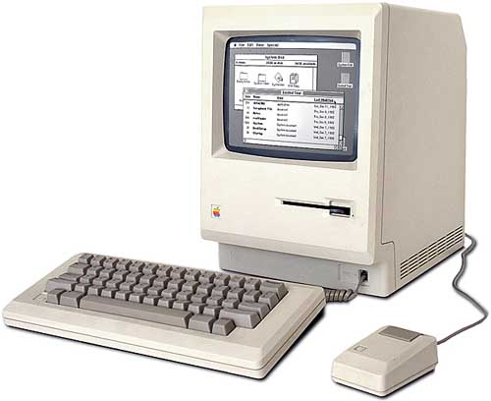
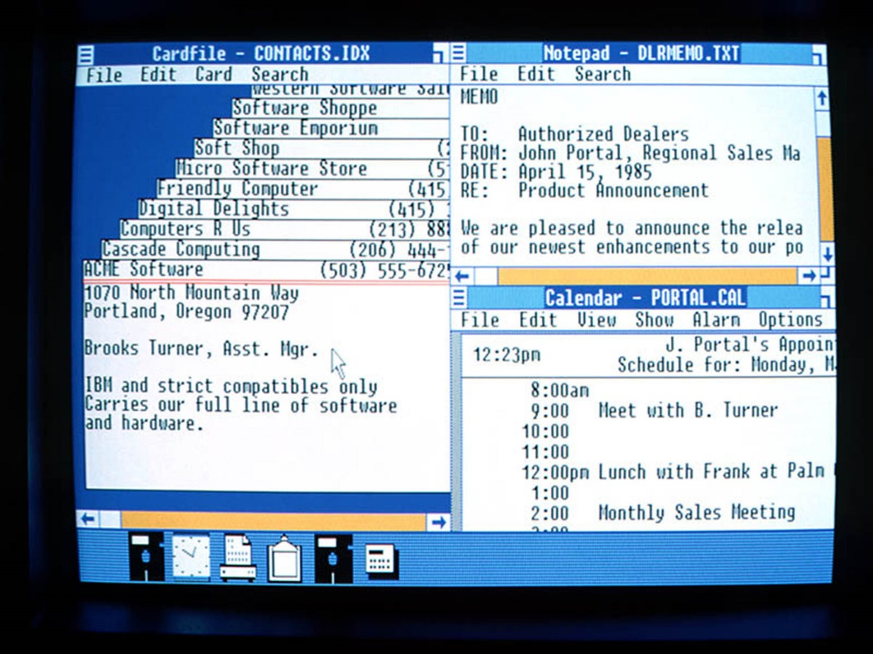
Topic B – Window Interface
Windows 1.0 / Macintosh (1985)
First mouse based interface
Applications open in own window
Widgets / Dialogues / Drop Down Menus
Many Program At A Time
Icons!
Trash Can!

Slide 24
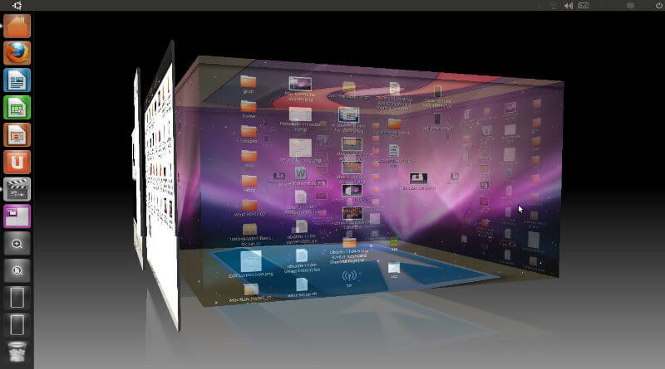
Topic B – Window Interface
Modern Graphical User Interface (GUI)
Multiple Workspaces / Accelerated Graphics
Touch Screen Interface
Network
Wide Reach

Slide 26
Assignment Overview
Objective:
To learn about the key parts of a software operating system (OS)
Process:
Level 1 : Rough Research
Level 2 : Organized Research
Level 3 : Final Concept Map
OS Topics:
Windows
Mac OS
Linux
Android
iOS

Slide 27
Important To Do
I will be marking the PROCESS as well as the PRODUCT.
Level 1 : Rough Research
I need to see content in this area!!!
Cut and paste rough research notes as you go.
Level 2 : Organized Research
I need to see stuff from Level 1 appear here!!!
Organise your rough research into common ideas
Reduce duplicated information
Re-word into your own voice
Level 3 : Concept Map
Select only the most important stuff from Level 2
Summarize into short bullet points
You will be MARKED DOWN if concept map is rust a repeat of Level 2

Slide 28
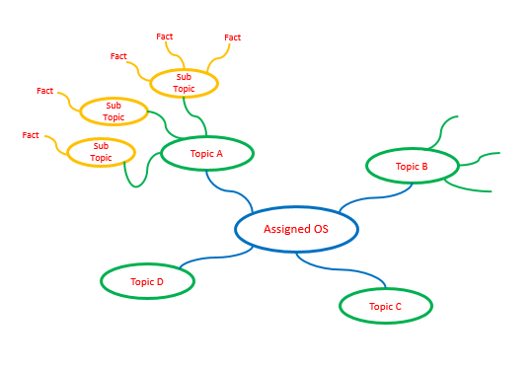
Concept Map
Use PowerPoint or another application of your choice.
Submit as PDF or Image File

